Slide 1
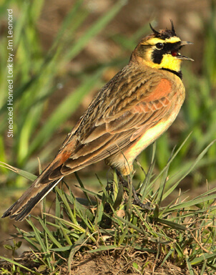
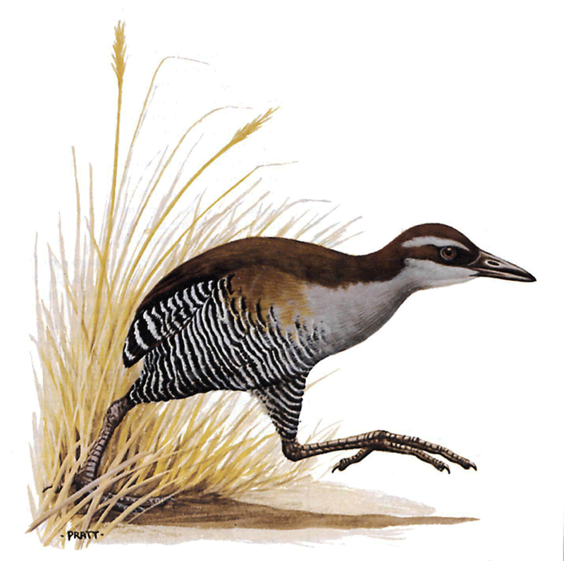
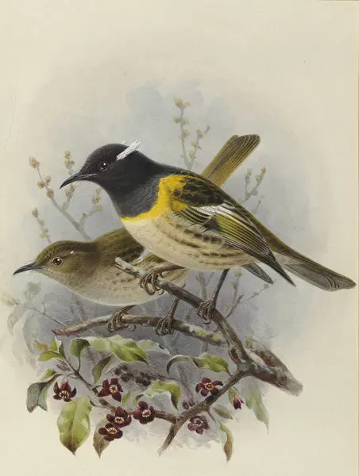
Expert elicitation for avian reintroductions
Hannah A. Sipeª and Sarah J. Converse^{b}
ªSchool of Environment and Forest Sciences, University of Washington, 98195 Seattle, WA.
^{b}U.S. Geological Survey, Washington Cooperative Fish and Wildlife Research Unit, University of Washington, 98195 Seattle, WA.

Slide 2
Reintroduction
What are reintroductions?
Conservation translocation, involving moving animals to a place they used to occur but no longer do
Decisions about reintroductions are difficult
Uncertainty
Tradeoffs
Risk of species loss
Notes:
Tradeoffs – for example, money vs. species outcomes
To overcome some of the complexity and difficulty, we need a tractable way to think about the problem

Slide 3
Structured Decision Making (SDM) Process
Define the decision problem to work on
Articulate objectives
Generate alternatives
Predict how alternatives will influence objectives
Optimize – tradeoffs
Decide and act
Adapted from Converse et al., 2013
Notes:
SDM is a great tool for dealing with and organizing complex problems
Basically, SDM breaks the problem down into components
Start the top
From the words of Hugh Possingham:
-Objectives – what do we want
-alternatives – what can we do
-predictions – how does what we do change what we want
-optimize – pick the best things to do to get what we want
-decide - do
This is the SDM process, how the problem is decomposed
Start at the top
We established a working group of decision makers, stakeholders, and scientific experts to develop these components

Slide 4
Adapted from Converse et al., 2013
Notes:
We run into a challenge when it comes to predictions in reintroductions a lot of the time
We need information on actions that haven’t been done yet
AND we can’t learn about the outcomes until after we have done it
So how do we make smart reintroduction decisions if we don’t have all the information (or any) necessary to make predictions?
Expert elicitation

Slide 5
Expert elicitation
Formalized and structured approach to eliciting information from experts about unknown or unavailable information
Using expert elicitation for reintroduction decisions is the best option we have in data limited situations
We use expert judgement everyday, but it is often implicit
Opportunity to update later with empirical data
Notes:
Definition
For reintro…
Obviously, empirical data are preferred, but during initial efforts they might not be available
Use it everyday
For example – asking which alternative is best
But that does help capture
Capturing an experts understanding about how a system works
Understanding how they came to that alternative
Through EE, we are making it explicit
This allows the initial judgement to be updated later with empirical data and understand how decisions were made
Using expert elicitation for reintroduction decisions is the best option we have in data limited situations
Usually do something implicit and just ask experts what they think is best, don’t consider difference between experts
-capturing the expert’s understanding about how the system works
Understand how they came to the alternative

Slide 6
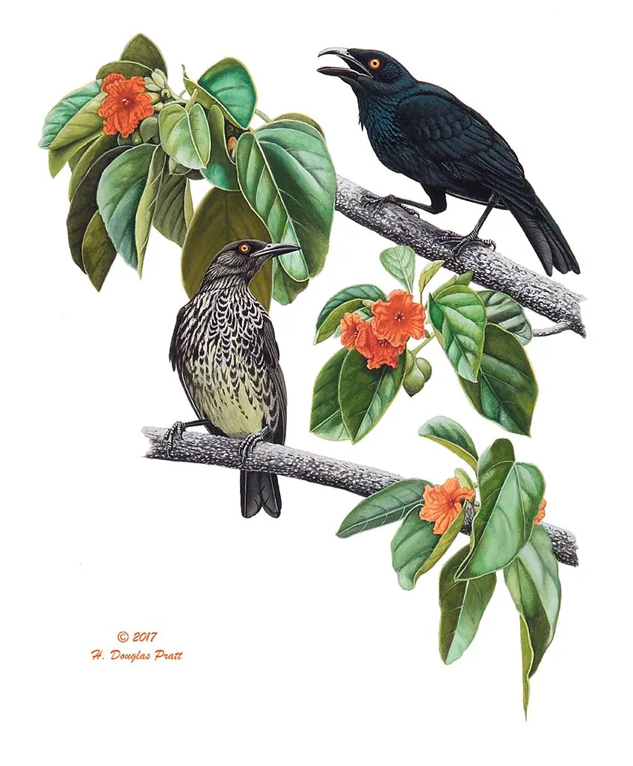
Notes:
In my dissertation research focuses on using decision tools to approach 3 reintroduction case studies
Each utilizes expert elicitation
So instead, today ...

Slide 7
Notes:
My last chapter is focused on developing a framework for reintroduction SHLA in WA state
I’m going to focus the rest of the talk on this project

Slide 8
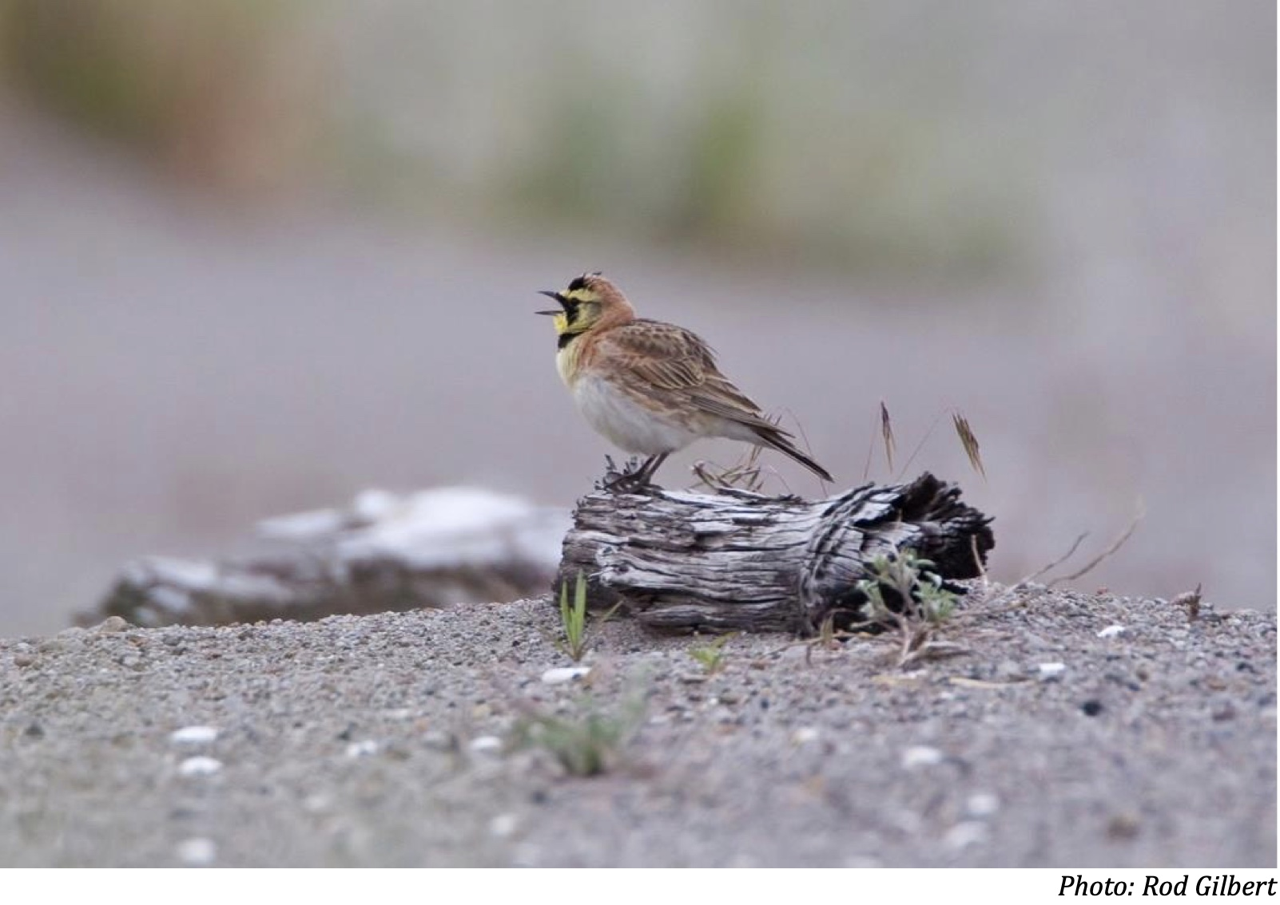
Streaked Horned Lark (SHLA; Eremophila alpestris strigata)
Ground-nesting grassland passerine and a subspecies of Horned Lark (Eremophila alpestris)
Found only in the Pacific Northwest
Federally listed as threatened

Slide 9
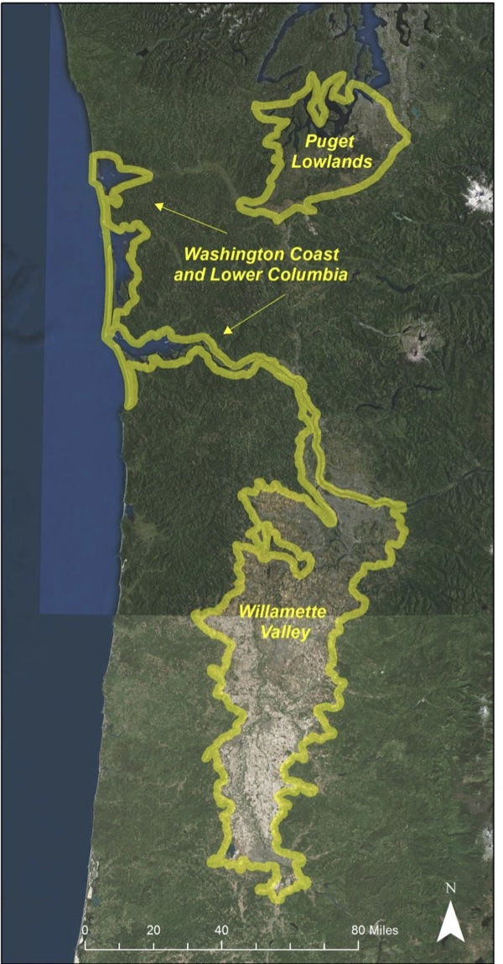
Anderson and Pearson, 2015
Notes:
There has been a marked breeding range contraction from their historic and today there are 4 regionally recognized populations – as you can see on the left
This is a result of human disturbance, habitat loss, and the cessation of natural ecological disturbances that create open and bare ground breeding habitat
In Puget sound – these populations occur on human dominated landscapes, such as on airports or military bases, that’s because human activities mimic those lost ecological processes

Slide 10
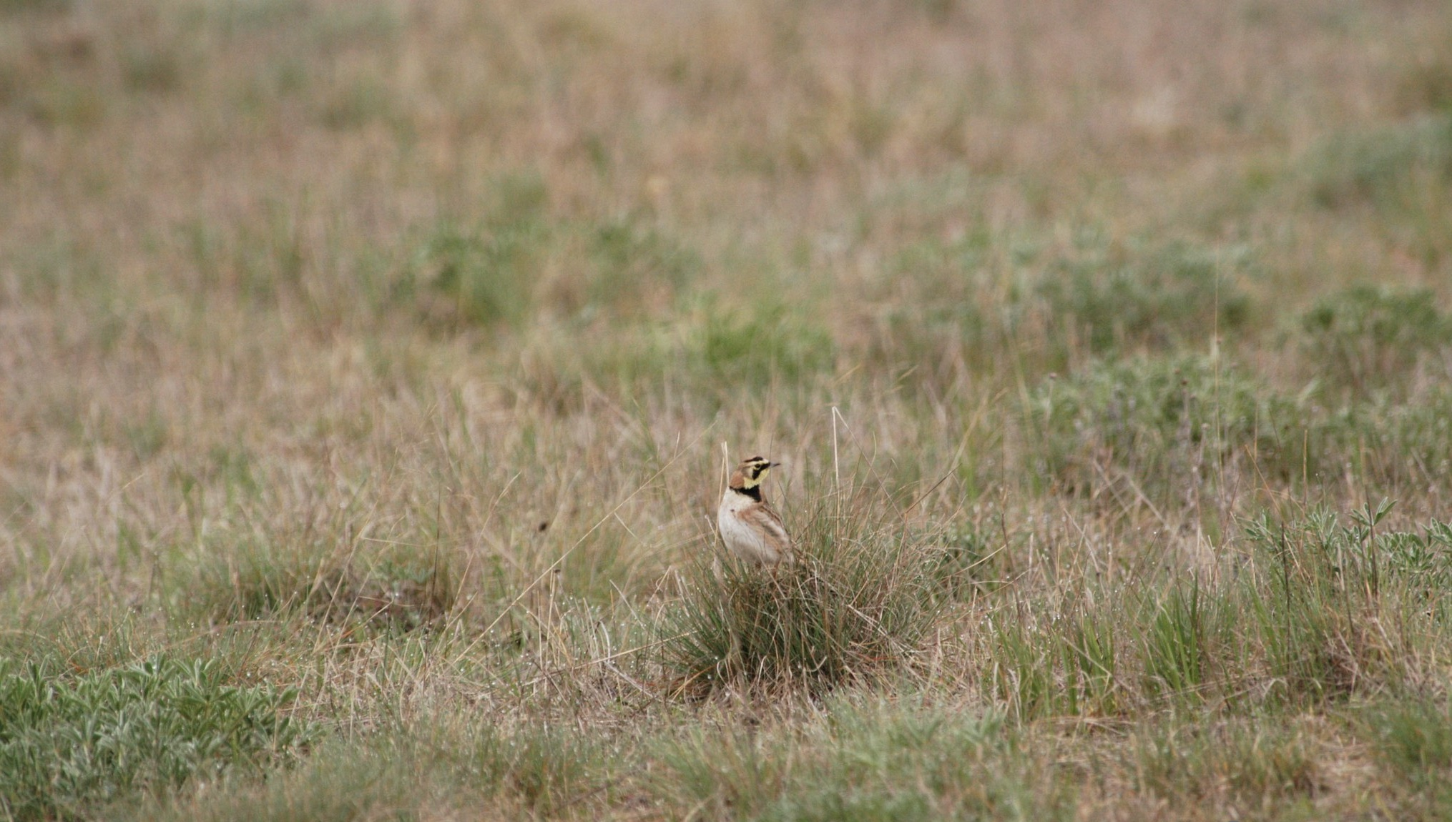
South Sound Prairies
Notes:
Although this population is being managed, they are still at risk of further decline. Hence, the establishment of additional regional populations has been identified as a priority for recovery
BUT – reintroductions are difficult, they cost a lot of money and carry a lot of risk of failure
So what we need is a framework to organize this complexity, help us think about lark reintroductions, and provide decision relevant information to managers
They have been managing this population, but they are still at risk of futher decline.
Hence, the establishment of additional regional populations through reintroducing SHLA to unoccupied sites has been identified as a priority for recovery in the draft recovery plan (U.S. Fish and Wildlife Service, 2019). Establishing additional populations will minimize the chance of further regional decline, thereby avoiding increasingly intensive and expensive conservation measures, such as the initiation of a captive breeding program.
BUT…Reintroductions are difficult – they cost a lot of money and carry a lot of risk of failure
What we need is a way to organize the complexity that helps us think about SHLA reintroduction

Slide 11
How Problem: How should managers undertake reintroductions of SHLA to unoccupied sites within South Puget Sound?
*
Notes:
Established a working group to frame the decision problem

Slide 12
How Problem: How should managers undertake reintroductions of SHLA to unoccupied sites within south Puget sound?
*
*
Maximize Number of SHLA Populations
Maximize number of SHLA populations
Notes:
I am just showing this one objective here, since it is the most important and requires the most consideration.
These objectives were intended to align with the recovery goals specified in the draft recovery plan for SHLA (U.S. Fish and Wildlife Service, 2019).

Slide 13
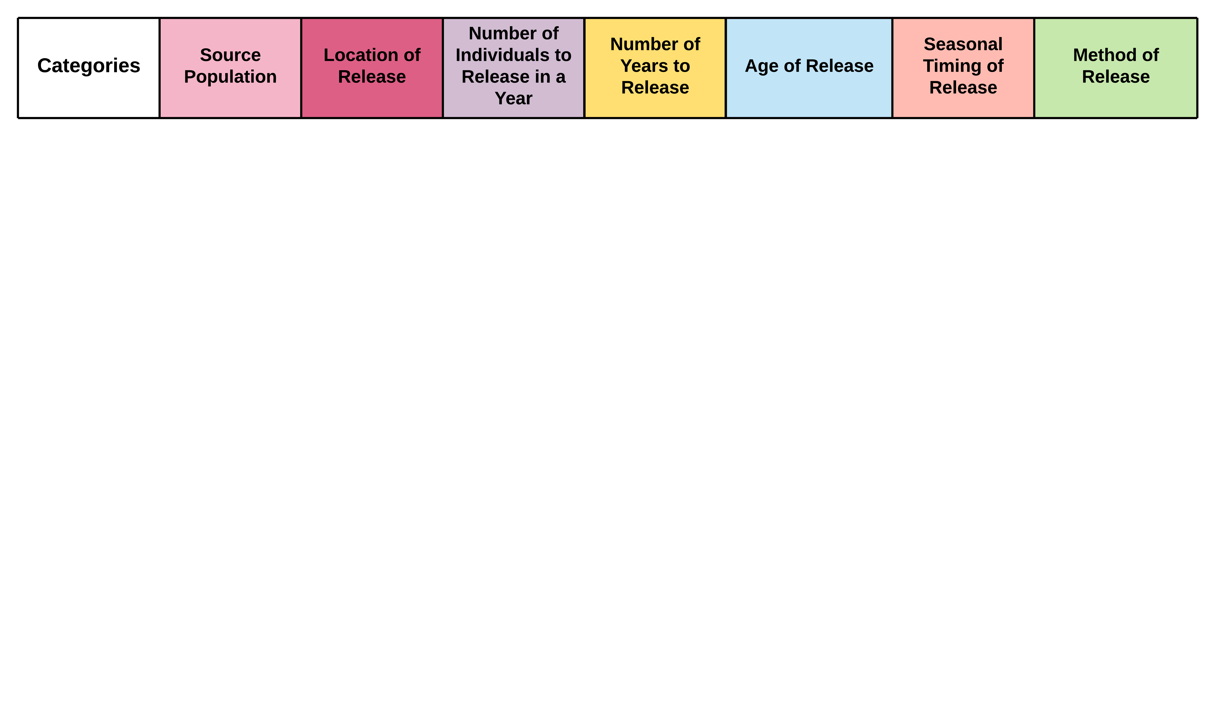
Alternatives
*
*
Reintroduction alternatives for SHLA are complex
Need to consider:
*
Where animals to translocate are coming from
Where animals are going to
How many individuals will be released
How many years to release
The age of the animals to translocate
What time of year to translocate animals
What method to use when releasing animals
Notes:
What we need is a logical way to arrange complex alternatives

Slide 14
Notes:
Strategy table approach

Slide 15
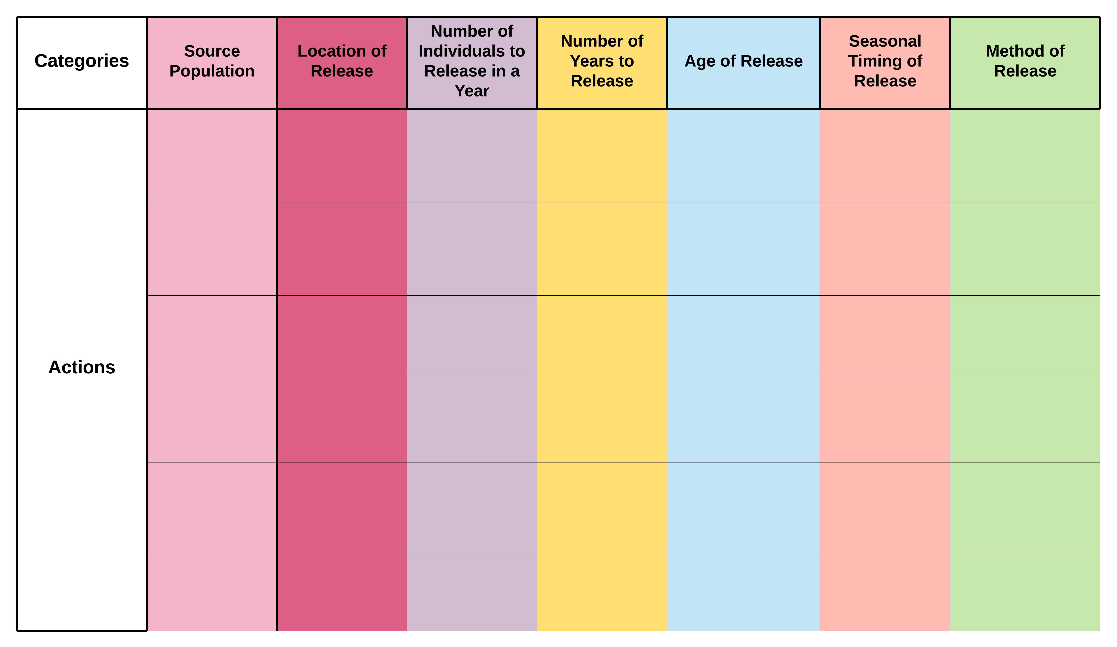
Notes:
Here I am showing the method we used to organize lark alternatives, this is known as a strategy table
What it does is places actions into categories (describe that)

Slide 16
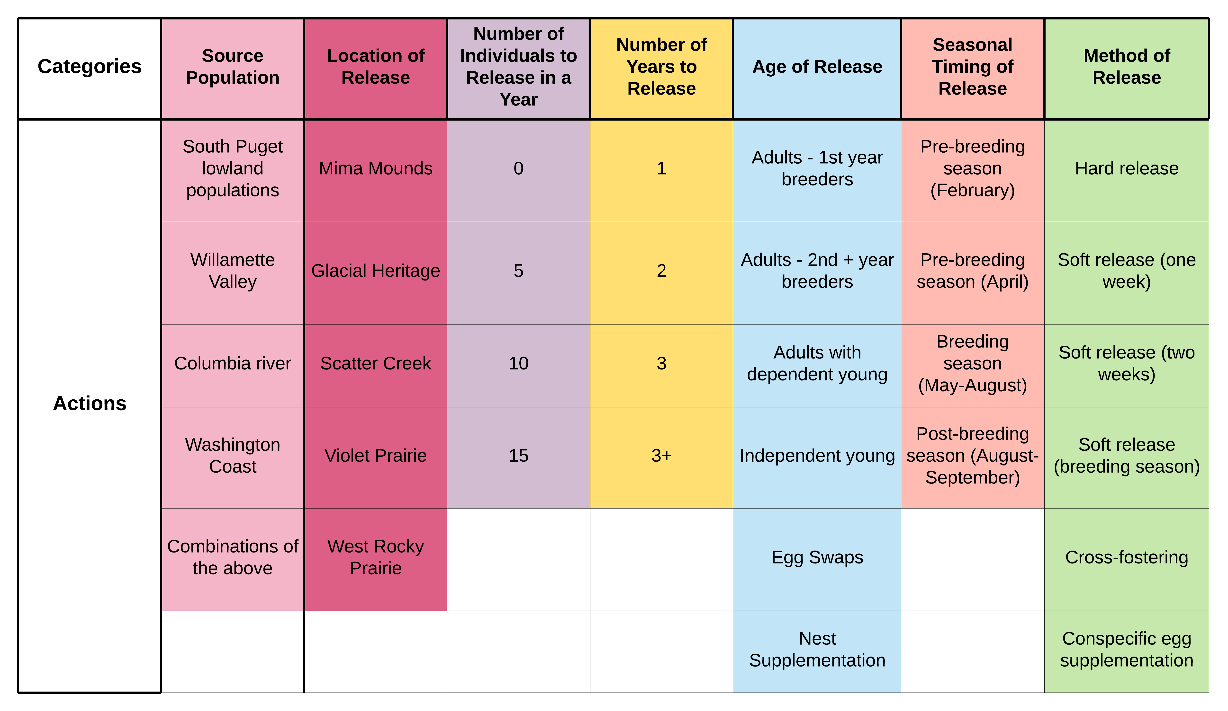
Notes:
Select actions from each category and form alternative strategies

Slide 17
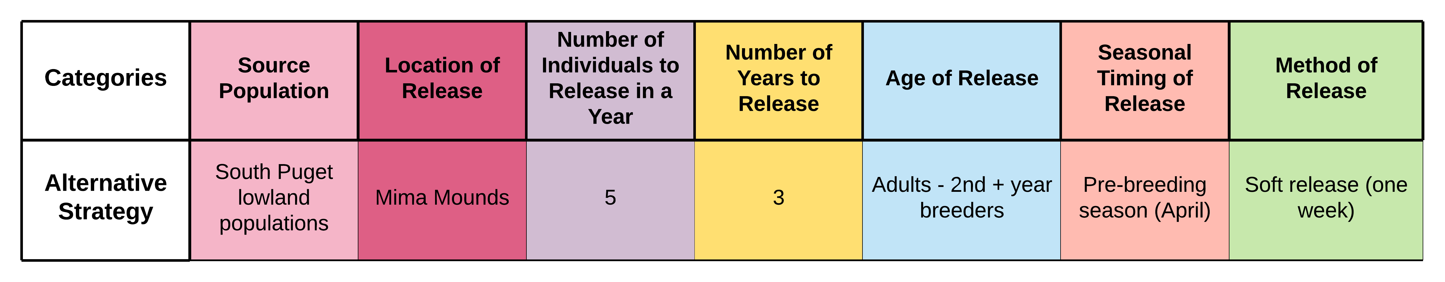
Notes:
Then alternatives are built by selecting actions from each category
-no assessing all possible, evaluate the strategies we want to
-captures the entire process

Slide 18
Predictions
*
*
What information do we have?
Information about current demographics (work by AE Bratt building an IPM)
Breeding ecology on monitored sites
What information don’t we have?
*
*
Notes:
Predictions
AND we can’t learn about the outcomes until after we have done it
How do we make smart decisions about SHLA reintroduction if we don’t have all the information we need to make predictions?
Elicitation
This decision is going to have to be made without every bit of empirical data we would like, there is simply no other way
Expert elicitation is the best option for making predictions

Slide 19

Notes:
So we need to get information using expert elicitation
This decision is going to have to be made without every bit of empirical data we would like, there is simply no other way
Expert elicitation is the best option for making predictions

Slide 20
Notes:
During our first elicitation process we elicited demographic rates for the most promising potential release sites
-basically, what would survival and fecundity be like if larks were at these sites?

Slide 21
Notes:
During our first elicitation process we elicited demographic rates for the most promising potential release sites
Occupied is black
SHLA Occ breeding sites
And Potential release sites
In South Puget Sound

Slide 22
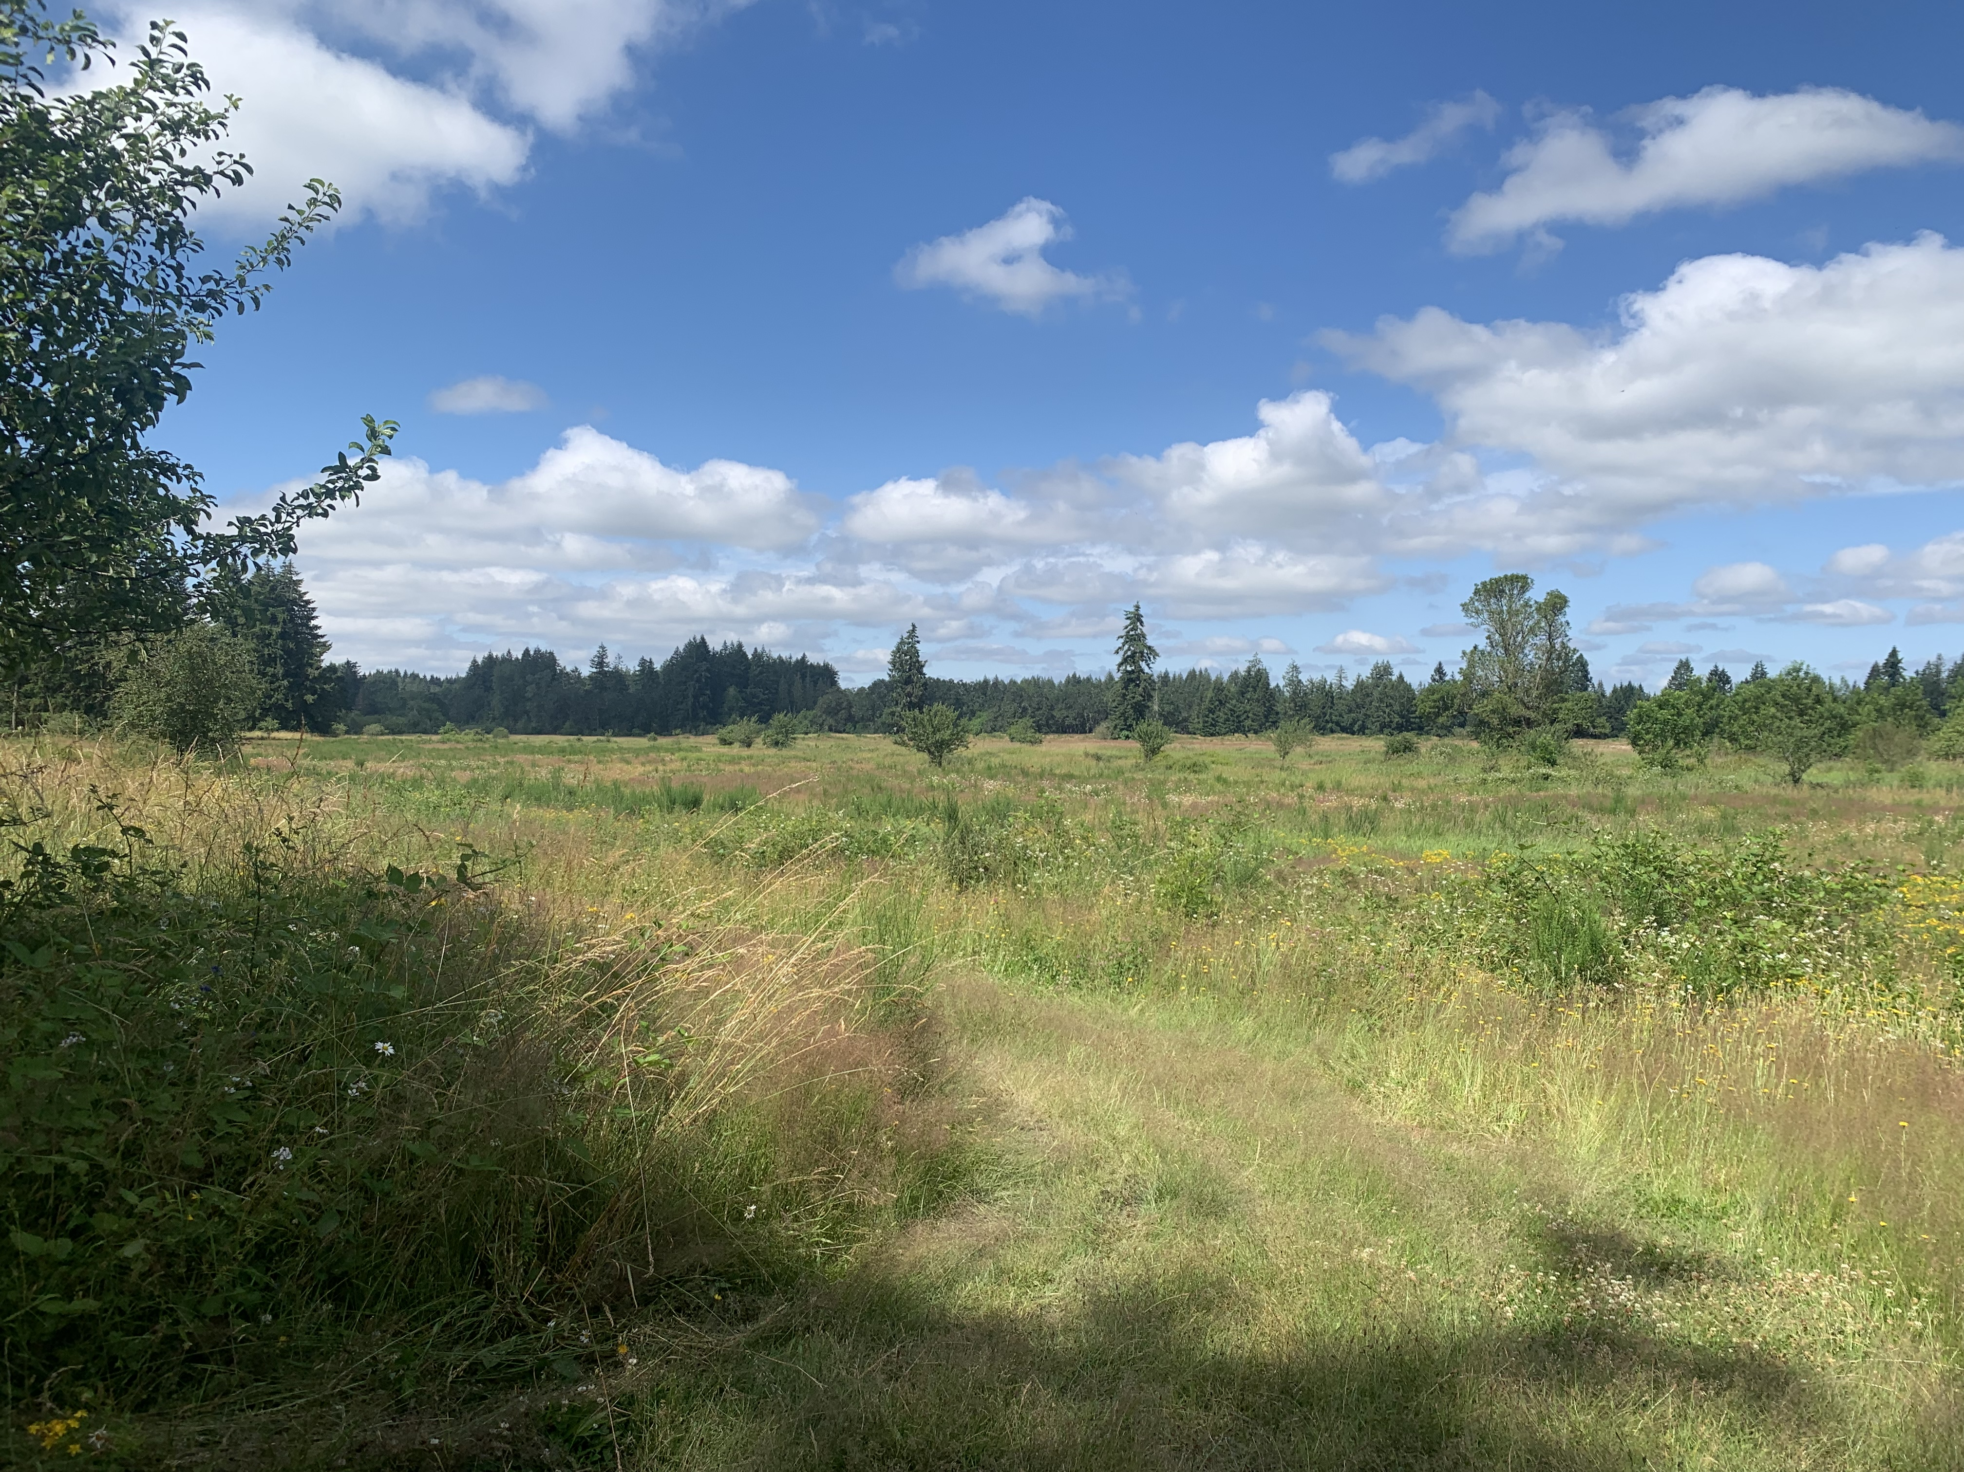
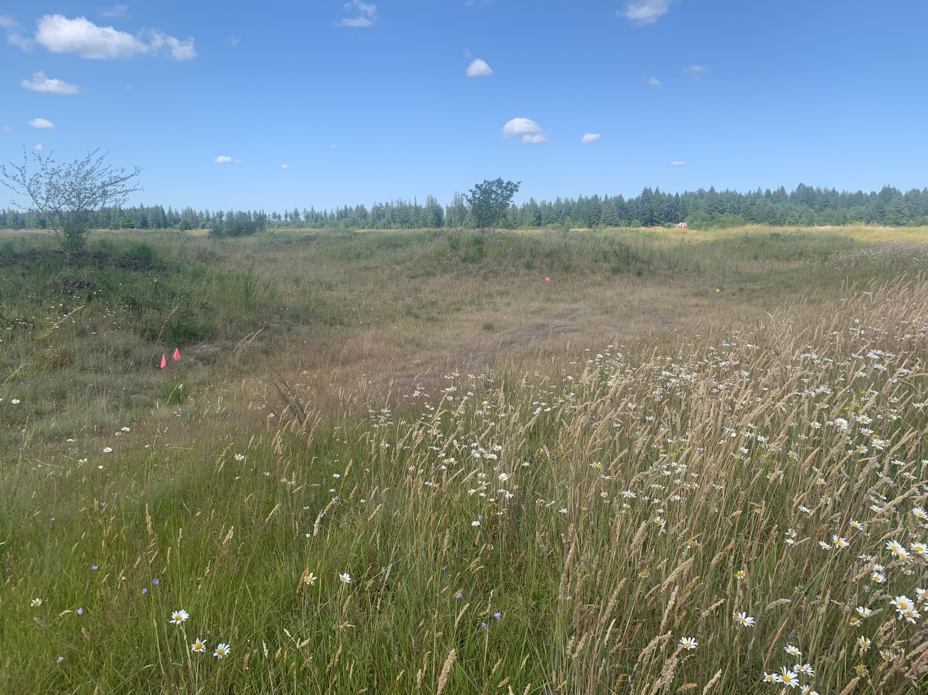
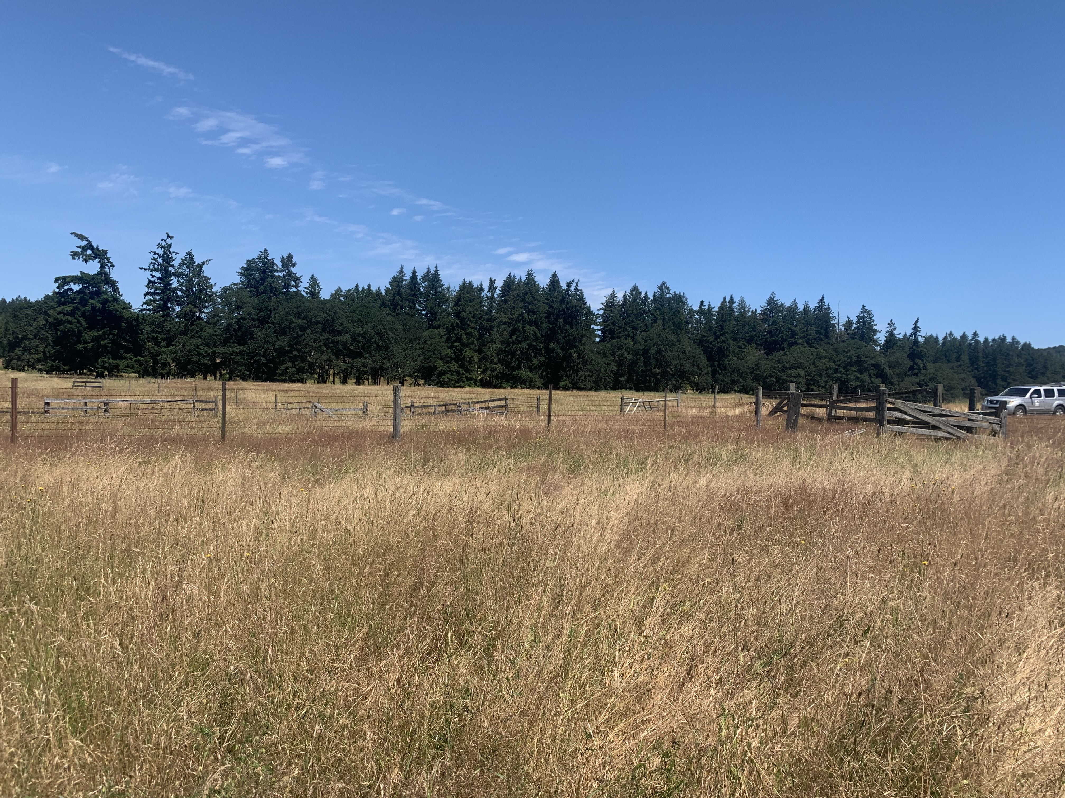
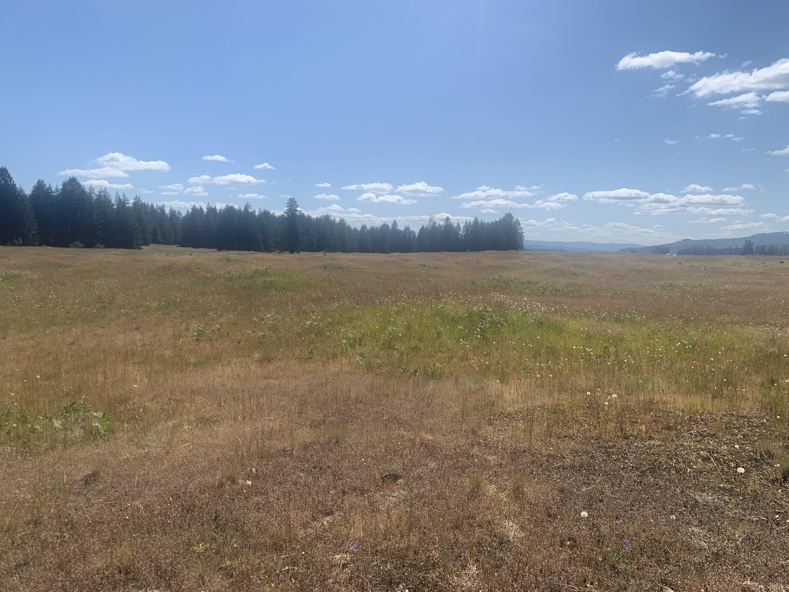
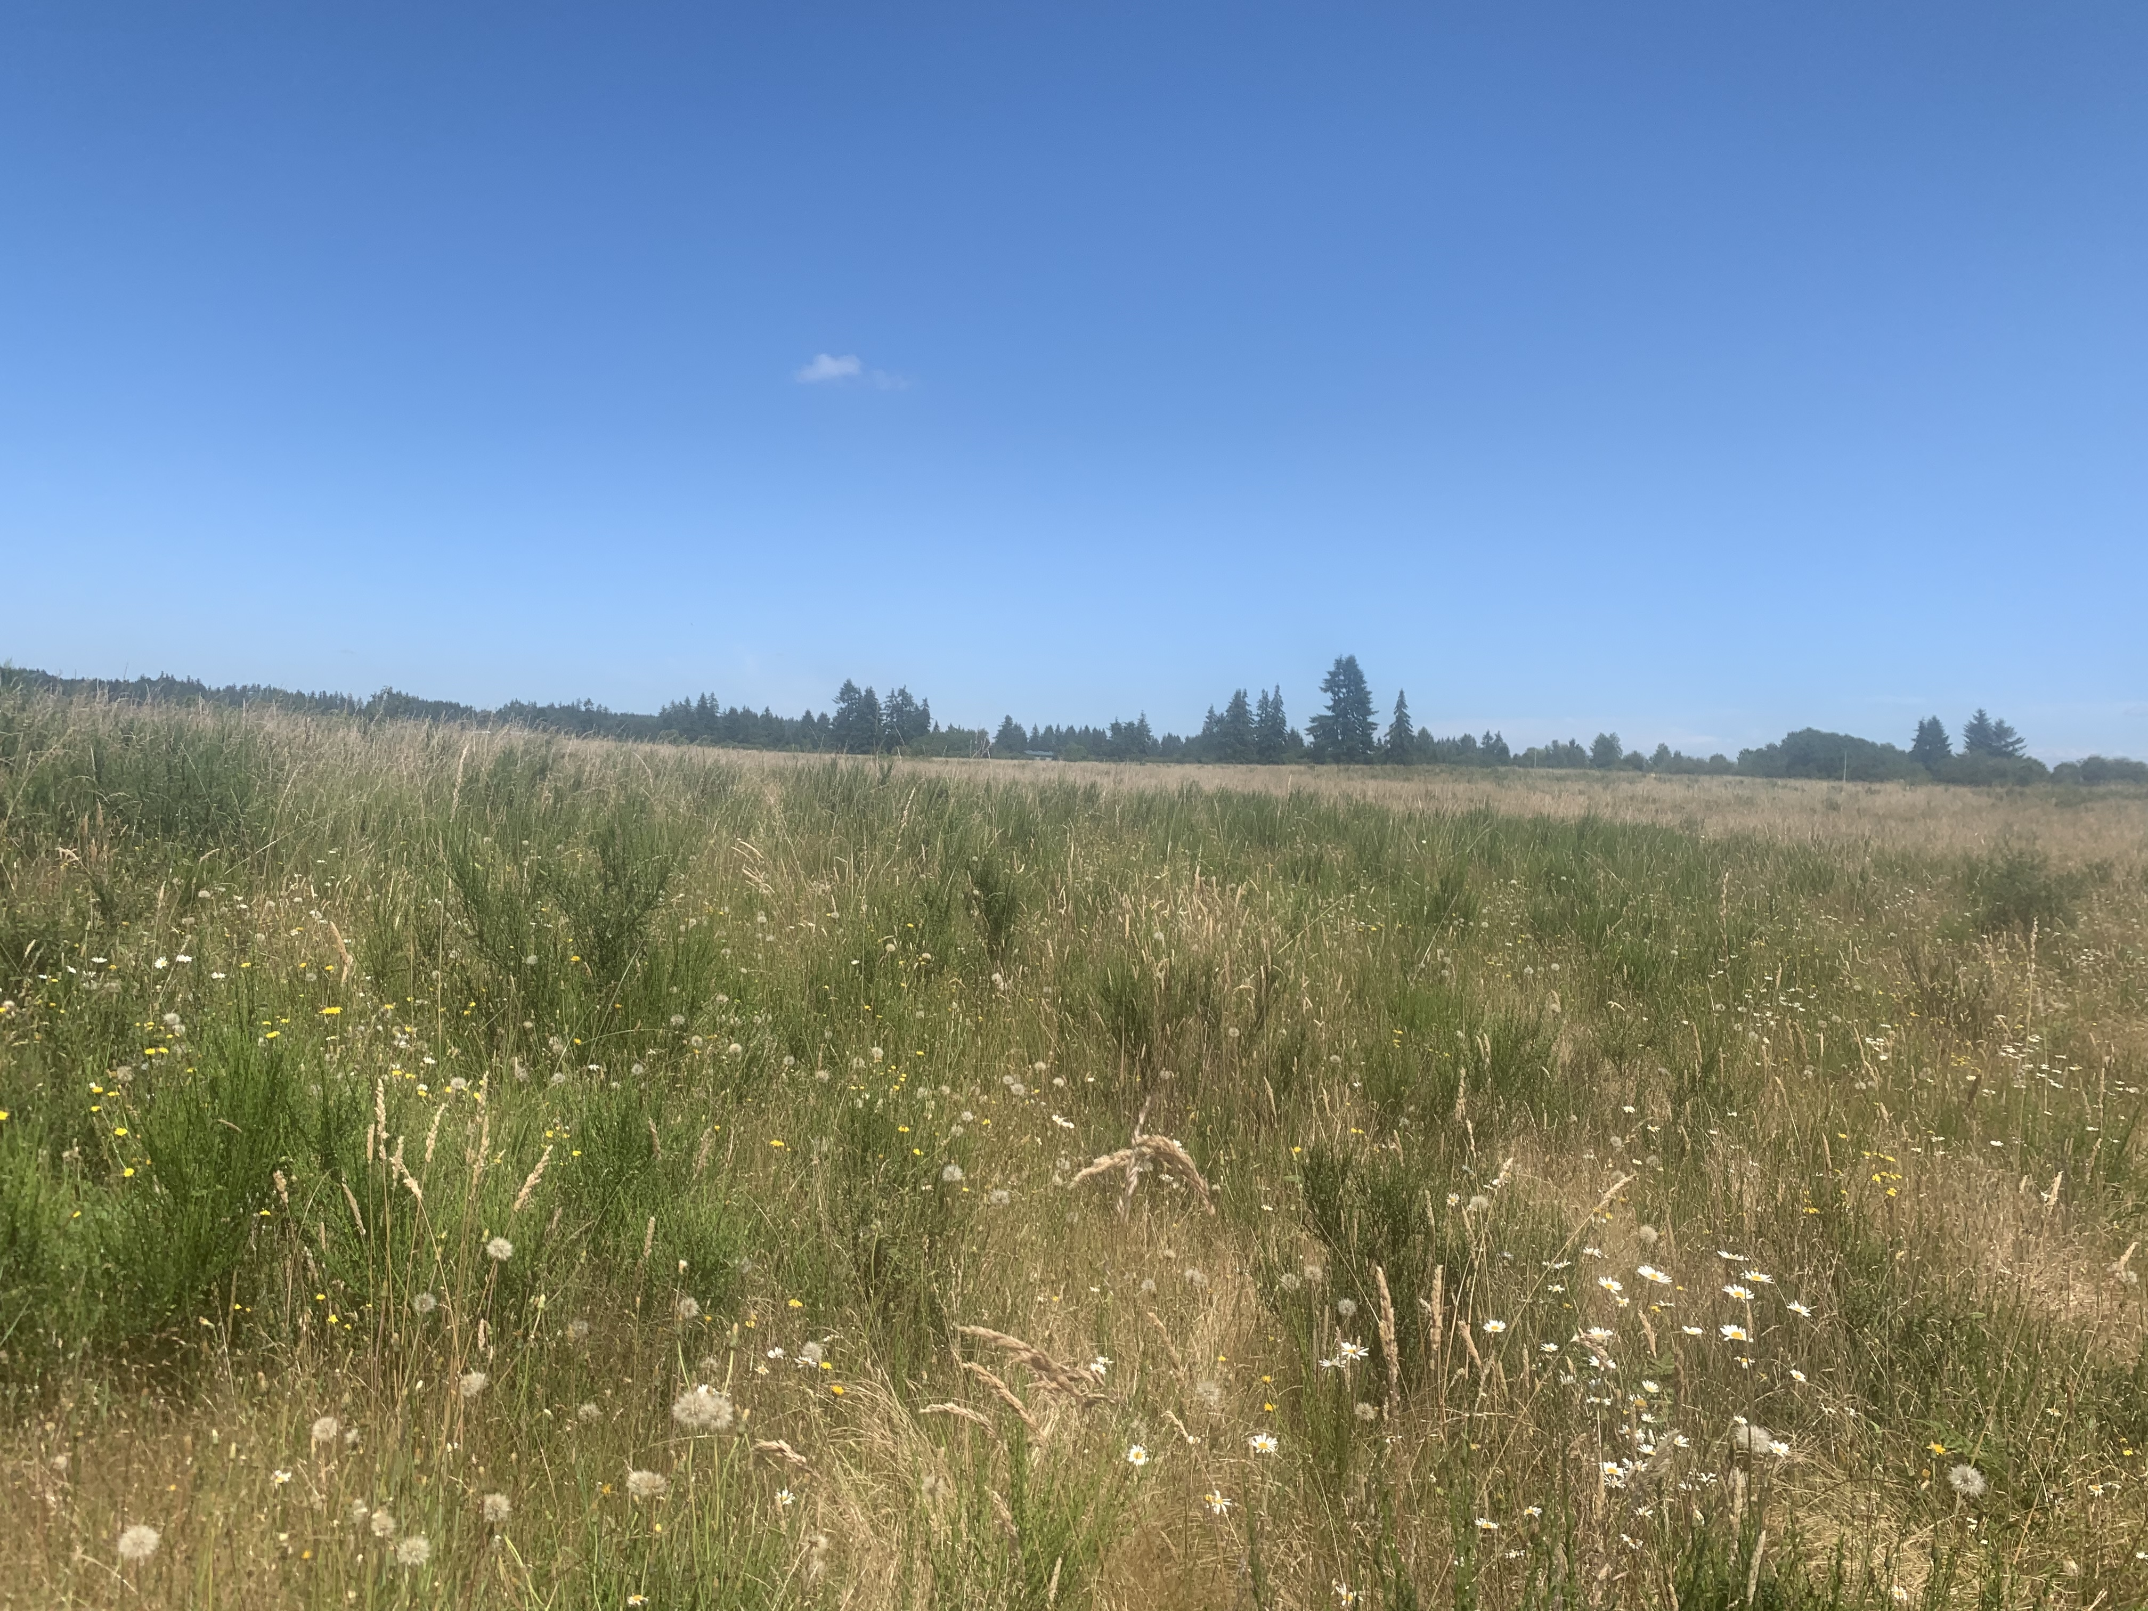
Notes:
Color coded textbox titles – remove legend, bigger pictures
Assembled a group of experts and as a group we went out to visit 5 promising potential release sites
Following site visits, we elicited information from the group following formal methods – which I don’t have time to get into here
But what we got out of this round of elicitation, is
Remove the titles

Slide 23
Elicitation process
4 experts
Parameters at potential release sites
Adult survival
Juvenile survival
Fecundity parameters
What would survival and fecundity be like if larks were at these sites?
*Not including post-release effects (yet)
Notes:
Add in carrying capacity?
Flow chart throughout the process, with difference between rounds

Slide 24
Methods
Modified Delphi process
All responses are kept anonymous throughout the process
Experts answer individually
The answers are summarized and shown to the group
The group discusses the responses
Experts are then given a chance to revise their responses
Process ends when no one wants to revisit their responses

Slide 25
Methods
4-point elicitation (Speirs‐Bridge et al. 2010)
What is your best guess?
What is the lowest possible value?
What is the highest possible value?
How confidence are you that the true value falls between your lowest and highest possible values? From 50% to 100%.

Slide 26
Methods – why use these?
Delphi process
Reduces anchoring on initial judgements or values
Minimizes negative group dynamics
Group think
Dominance by group members
4-point elicitation
Reduces overconfidence in expert elicited values

Slide 27




For each site and each parameter:
Best guess at each site
Highest possible value
Lowest possible value
% confidence that the interval from lowest to highest captures the true value
Notes:
4 point elicitation method
Modified Delphi process

Slide 28
Notes:
Elicited distributions for survival and fecundity at each site
Now, these can be used to make predictions about larks at any of these sites
We still need information on other management actions, but we need to undergo another round of elicitation for them

Slide 29
Initial predictions under no management
Notes:
Here I am showing some initial predictions, just looking at the predicted total number of adults under scenarios where 5,10,15 adultls are released
Experts agree with the what they saw at the sites
Interestingly, when we went out to visit the sites, the experts were all very excited about the potential at glacial heritage. In that way, our use of expert elicitation hasn’t uncovered some unknown preference, but has quantified and documented it in a way that can be updated after the ability to model using empirical data.
Here I am showing some initial predictions about adult and juvenile larks at the 5 potential sites if 20 adults were released.
But note, that these are just initial predictions and do not include any other management action effects or post-release effects.
This is really just to illustrate how predictions will be made once we have all the elicited information we need.
And to show how expert elicitation and predictions will allow us to compare various strategies.

Slide 30
Initial predictions under no management
Notes:
Here is what happens if we do 3 additional releases in years 1,2,and 3
Experts agree with the what they saw at the sites
Interestingly, when we went out to visit the sites, the experts were all very excited about the potential at glacial heritage. In that way, our use of expert elicitation hasn’t uncovered some unknown preference, but has quantified and documented it in a way that can be updated after the ability to model using empirical data.
Additional management actions will be included, but we need to undergo another round of elicitation for effects of other management effects
Post release
Doug post release paper as next steps
Here I am showing some initial predictions about adult and juvenile larks at the 5 potential sites if 20 adults were released.
But note, that these are just initial predictions and do not include any other management action effects or post-release effects.
This is really just to illustrate how predictions will be made once we have all the elicited information we need.
And to show how expert elicitation and predictions will allow us to compare various strategies.

Slide 31
Outcomes
Quantified expert judgements
No unknown preference was uncovered
Provides initial information to base decisions on (shows others how the decision was made)
Allows these values to be updated later when empirical data are available
Notes:
Experts preferences and knowledge was quantified
Interestingly, when we went out to visit the sites, the experts were all very excited about the potential at glacial heritage. In that way, our use of expert elicitation hasn’t uncovered some unknown preference, but has quantified and documented it in a way that can be updated after the ability to model using empirical data.

Slide 32
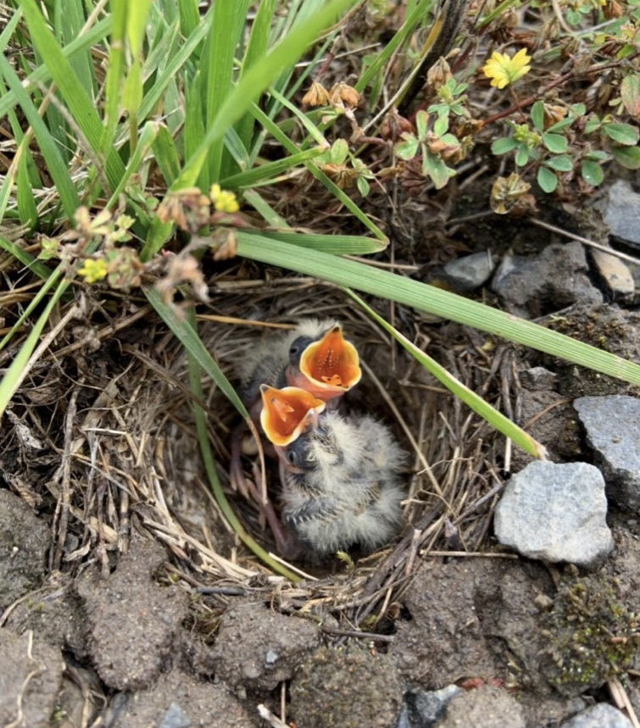
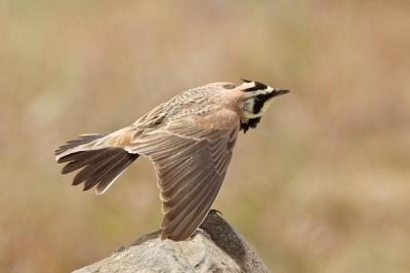
Significance and implications
Provide managers and stakeholders with a framework for evaluating SHLA reintroduction strategies
Tractable representation of the decision problem
Transparent and adaptable framework
Nick Atwell
Notes:
This is still a work in process and need to finish up some elicitation and predictions, but the end result…
Transparent and adaptable – expert elicitation
Broader -> reintroduction case studies bullet points
This is still a work in progress, but the end result will provice managers and stakeholders with a framework for evaluating lark reintroduction strategies and help them make informed decisions
We would not have gotten very far without expert elicitation

Slide 33
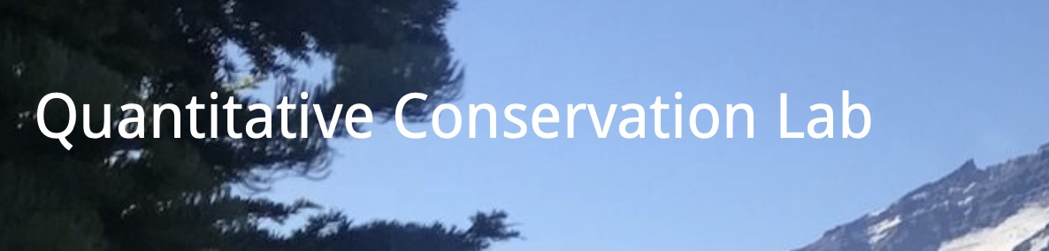

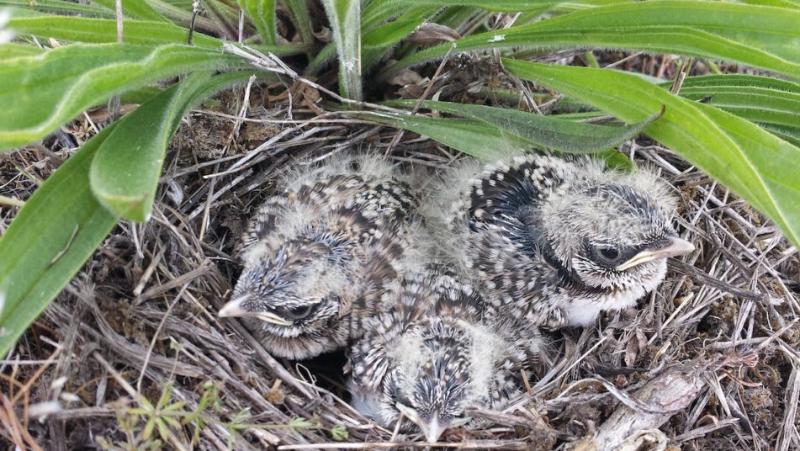

Co-authors:
Gary Slater, Ecostudies Institute
Abby Bratt, UW
Collaborators:
Scott Pearson, WDFW
Jim Lynch, JBLM
Wendy Connelly, WDFW
Bob Altman, ABC
Martin Nugent, ODWF
Ilon Logan, FAA
Darric Lowery, WDFW
Sanders Freed, CNLM,
Adam Griesemer, USFWS
Zach Radmer, USFWS
Chris Chaput, Thurston County
Tim Leque, CEMML
Adrian Wolf
Notes:
Add Gary and Abby as co-authors on this

